Slide 1

Introduction to AI(AI101B) Even Semester Session 2024-25
Resume Screening using BERT
Team Members:
Mradul Tyagi (2410116100125)
Gargi Singh (2410116100072)
Nainsi Jain (2410116100128)
Project Supervisor:
Mr. Apoorv Jain
Assistant Professor

Slide 2
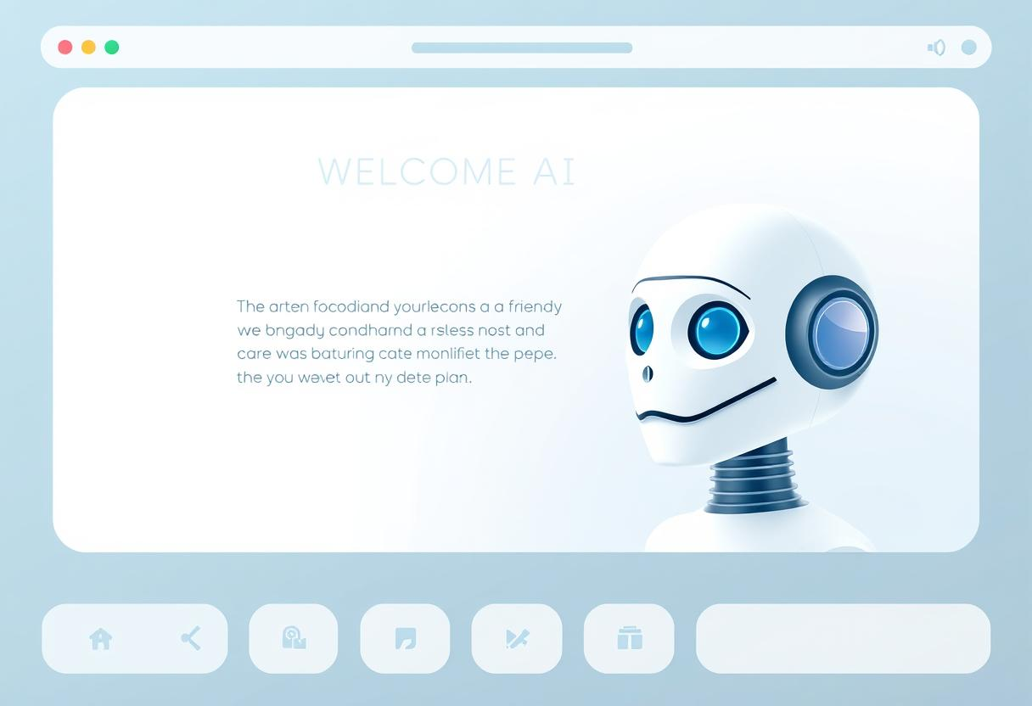
Introduction
This project introduces an AI-based resume screening system that uses BERT to understand the context and meaning of resume content, not just keywords.
It provides confidence scores and suggestions to improve resume alignment with predicted roles.
Includes a simple Streamlit web app for uploading resumes and viewing results instantly.
An AI-powered solution for classifying resumes. This project showcases contextual understanding and job role prediction using deep learning.
Resume Screening
Notes:
Font Styles: Times New Roman + Font Size: 25

Slide 3
Objective of the Project
Objectives
Contextual Understanding
Understand context in resume text for accurate role prediction.
Confidence Scoring
Provide confidence scores for each classification result.
Improvement Suggestion
User Interface
Offer suggestions to improve resume relevance for the predicted role.
Generate immediate and meaningful replies for varied user queries.
Notes:
Font Styles: Times New Roman + Font Size: 25

Slide 4
Methodology
Dataset Preparation
Custom dataset with resumes labeled by job role
Cleaned and tokenized text using BERT tokenizer
Split into training and testing sets
Model Training
Fine-tuned pre-trained BERT for multi-class classification
Used CrossEntropyLoss and Adam optimizer for training
Resume Classification Pipeline
Text preprocessing → Tokenization → BERT prediction → Confidence scoring
Streamlit App Development
Built a responsive web UI for resume upload and prediction display
Includes extracted text, predicted role, confidence score, and suggestions

Slide 5

Tech Stack
Programming Language: Python
NLP Library: HuggingFace Transformers
Model: BERT
Web Interface: Streamlit
Data Handling: Pandas, Numpy
Evaluation: Scikit-learn
PDF Text Extraction: pdfplumber

Slide 6
Application Demo
Users upload a PDF resume
via
the Streamlit interface
The app extracts and
preprocesses the resume text
Displays:
Predicted role
Confidence score
Suggestions to improve resume
alignment
The model predicts the most relevant job role
Notes:
Font Styles: Times New Roman + Font Size: 25

Slide 7
Results and Analysis
Model Performance
Average Metrics:
Precision: 0.87
Recall: 0.84
F1 Score: 0.85
Accuracy: 86%
Slightly lower accuracy in overlapping roles
Web Developer vs. Software Developer
Data Analyst vs. Data Scientist
Confidence Score Distribution:
Correct predictions mostly above 85% confidence.
Incorrect predictions in 50-70% confidence range.
Enables trust in high-confidence outputs and flags uncertain cases for review.

Slide 8
Challenges Faced
1
Inaccurate labeling due to keyword-based tagging
2
Processing large resume text efficiently
3
Imbalanced dataset across job roles

Slide 9
Future Enhancements
1.
Expand to more job roles and larger datasets.
2.
Integrate with HR software.
3.
Use of Resume Ranking and Recommendation System

Slide 10
Conclusion
This project successfully built an AI-powered resume screening system using BERT and Streamlit.
It delivers real-time predictions, confidence scores, and actionable feedback, making it highly practical for recruiters and job seekers.
The modular design ensures the solution is scalable and ready for future integration into HR systems and job portals.
With improvements in data quality, resume parsing, and multi-language support, this system has the potential to become a complete hiring assistant.

Slide 11
THANK YOU!

